Slide 1
South African Air Quality Information System (SAAQIS)
Patience Gwaze, Department of Environmental Affairs
2nd ANNUAL WeatherSMART SCIENCE SYMPOSIUM: South African Weather Solution for Everyone, Everyday
18 March 2019, Royal Elephant Hotel, Centurion

Slide 2
Presentation Outline
  Air Quality Information Systems in South Africa
  Objectives of SAAQIS
  Brief History on SAAQIS
  SAAQIS Infrastructure
    Data Flow Processes
    Data Quality Control and Quality Assurance
    SAAQIS WeatherSmart Functionalities
  Looking Forward

Slide 3
South African Air Quality Information System (SAAQIS)
South African Air Quality Information System (SAAQIS)
Legal tool for disseminating air quality information in South Africa nationally to all stakeholders
  One stop-shop for all stakeholders (public, policy-makers, academia etc.)
  Support the implementation of the National Environmental Management Air Quality Act and all legislations.
  Support of the National Ambient Air Quality Monitoring Network (NAAQMN)
  Hosted by the South African Weather Service
South African Atmospheric Emission Licencing and Inventory Portal (Atmospheric Emission Licencing and Emissions reporting systems)
  Online emissions management tools supporting over 1400 industrial and mining operations nationally

Slide 4
National Framework: SAAQIS Objectives
South African Air Quality Information System (SAAQIS) aims to:
Ensure that air quality information management and reporting requirements directed or implied by the AQA are met efficiently and effectively;
Ensure that air quality management decisions, interventions, activities and actions are informed by accurate, current and complete information;
Ensure that accurate, current, complete and relevant air quality information is available to all stakeholders and the public;
And provide all South African’s with information on the state of their air quality and the status of efforts to progressively ensure their right to air that is not harmful to health and well-being.

Slide 5
SAAQIS – A Brief History
SAAQIS first generation developed in 2007
Launched in 2009, and implemented from 2009-2011
SAAQIS second generation launched during AQ Governance Lekgotla in 2017
Second generation SAAQIS includes:
  LIVE reporting of ambient monitoring to the public via SAAQIS website and mobile application
  Improved dissemination of information to the public
  Effective online Assets Management System of the ambient air quality monitoring stations

Slide 6
SAAQIS Infrastructure

Slide 7
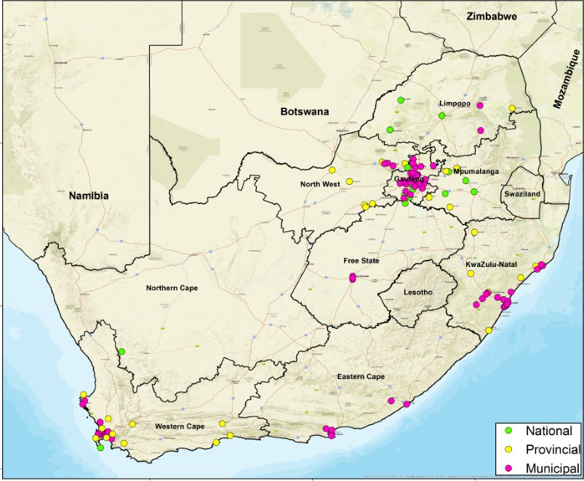
National Ambient Air Quality Monitoring Network
There are currently 130 government owned stations across the country
Monitor all criteria pollutants, black carbon and H2S
Of these an average of 65 are reporting to SAAQIS
Out of these 65, about 62 stations are reporting LIVE to SAAQIS
15 private stations coming in 2019

Slide 8
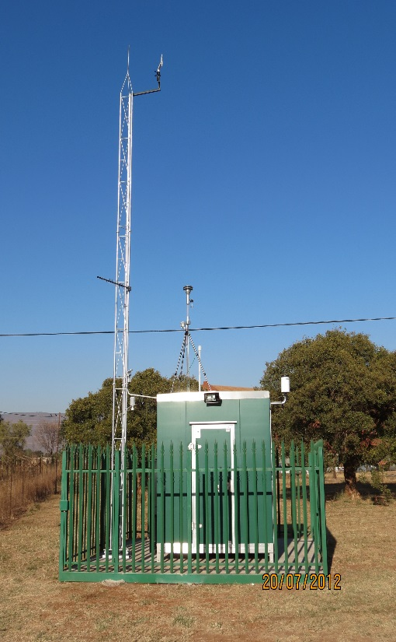
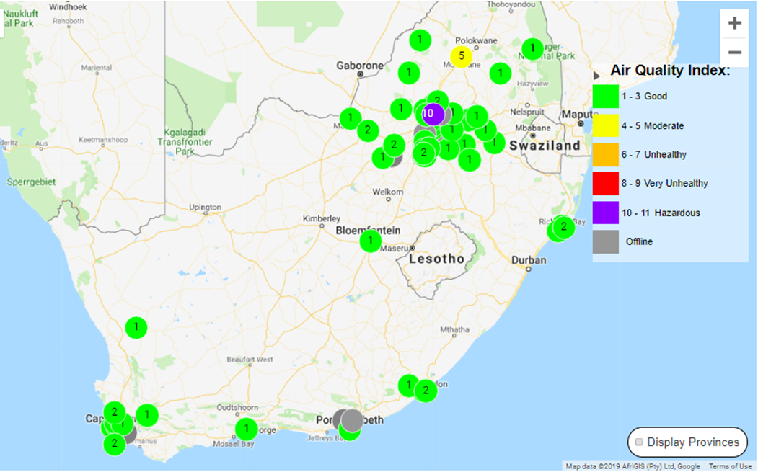
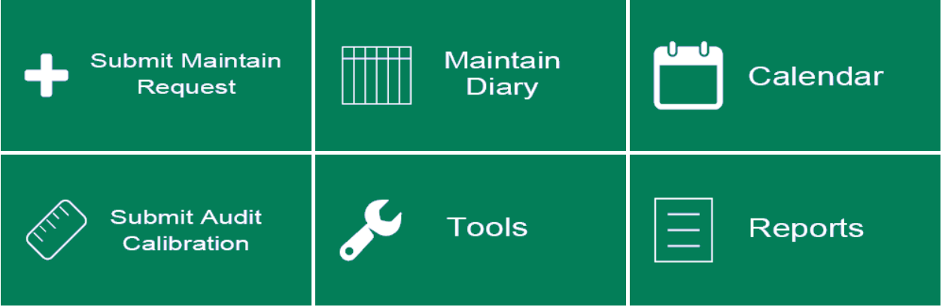
Ambient Monitoring Data Flow
DYNAMIC DISPLAY& GIS
ANALYSE
REPORTS
COMMUNICATION MODULE
SAAQIS DATA ASSURANCE
SAAQIS DATA MANAGEMENT
EDIT DATA VALIDATE
PUBLIC DISTR.(MOBILE, WEBSITE ETC
ASSET MAN.

Slide 9
SAAQIS
SAAQIS Website
Interfaces: website and mobile app
Mobile APP
NAAQMN– Data Management and Reporting Module
Maintain View- Asset Management Module
Databases, document catalogue and data management system
Document Cataloguing Module
Events/Conferences/ Links
Learners Corner
Complaints Register
AQMP Information
SAAELIP
National Ambient Air Quality Monitoring Network (NAAQMN) – Station Management Module
NAAQMN – ambient monitoring stations

Slide 10
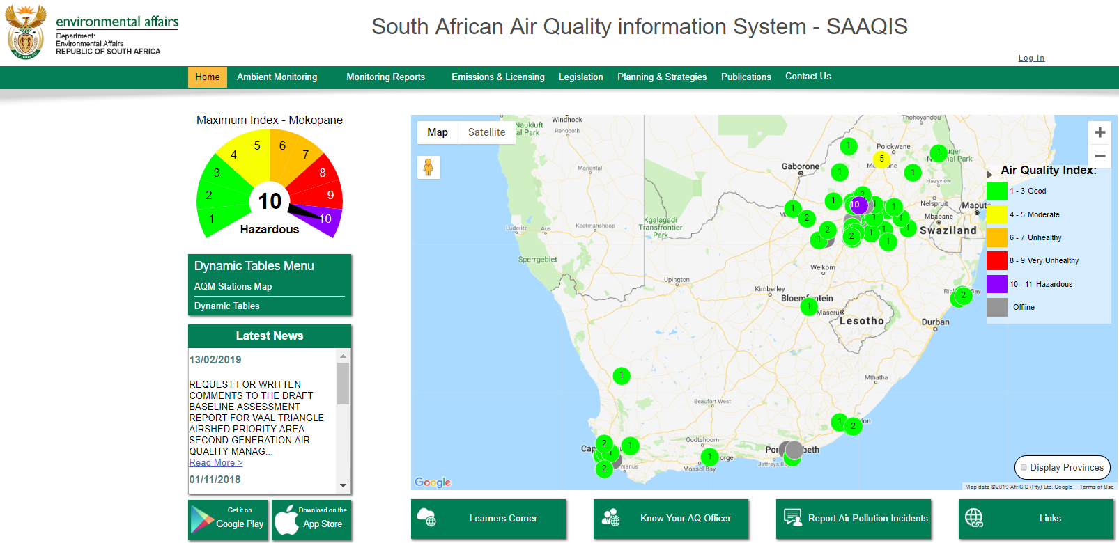
SAAQIS Website
Air Quality Index

Slide 11
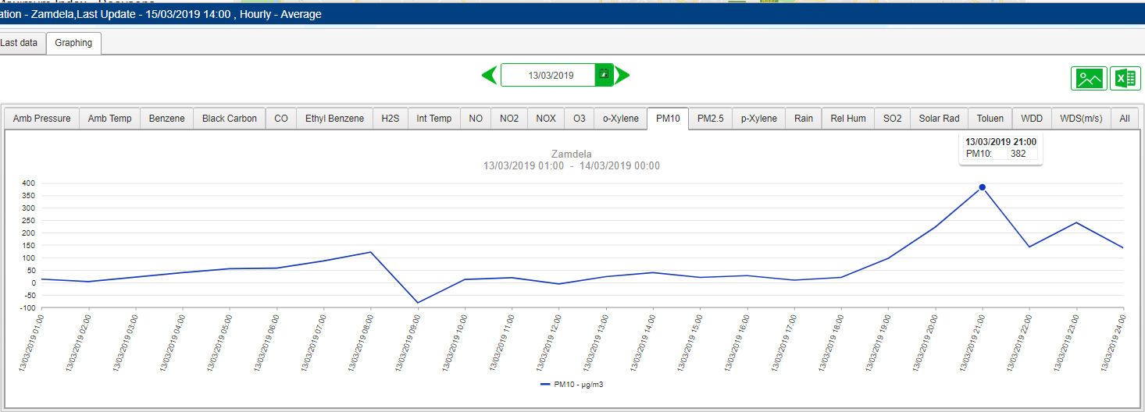
SAAQIS Website
Download Excel Data

Slide 12
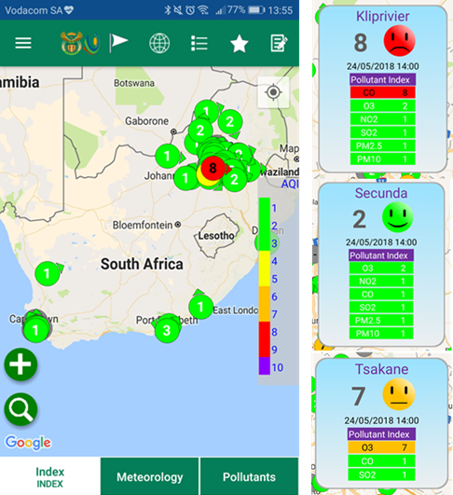
SAAQIS Mobile Tool – Ambient Monitoring Information
  Available on Android and on IOS
  LIVE INDEX, POLLUTANTS, METEOROLOGY
  Ability to plot historical data
  Generate reports
  Set APP for personal use with specific stations of interest, settings

Slide 13
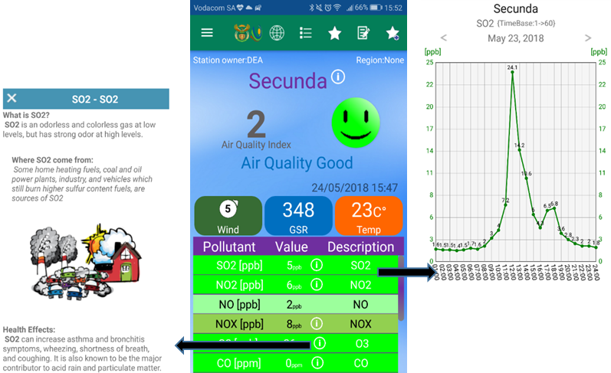
SAAQIS Application Data and Information

Slide 14
How is SAAQIS WeatherSMART?
Freely available smart application tool for, website IOS and Android platforms
Provide real-time state of air quality across the country
Data is presented as an AQI, a simplified classificafion on the state of air from 1 (good air quality ) to 10 (hazardous air quality)
Data is quality-controlled using system algorithms before disseminating to the public (further QA/QC follows)
SAAQIS application tool shared with stakeholders continuously
NAAQMN data can be freely downloaded as Excel/TXT files for a period of up to a year from all stations for all pollutants

Slide 15
SAAQIS: Looking Forward
Continuously improving SAAQIS
  Strengthening AQ monitoring QA/QC systems - online management of most network operations
  Developing a National AQ Monitoring Quality System to support ALL government stations towards ISO:17025 compliance
  National interventions to improve national monitoring – 43 stations now managed under a strategic station program until 2022
  More interventions under development to improve national coverage
  Ongoing capacitation of stakeholders
Further ensuring that SAAQIS becomes the go-to platform for all AQM
SAAQIS Awareness Programs through universities and other stakeholders

Slide 16
SAAQIS Looking Forward
Norms and Standards for AQ Monitoring – improving regulatory requirements
Ensuring sustainable monitoring and continuous improvements in data quality
Predicting extreme AQ events
Evolving technologies in data collection, interpretation and presentation e.g., machine learning
Understanding the impact of SAAQIS on human behavior
Dissemination of information – regionally and globally

Slide 17
Thank You
Patience Gwaze
Department of Environmental Affairs
012-399-9192
079-216-0792 pgwaze@environment.gov.za https://saaqis.environment.gov.za/

